Slide 1
State Patterns
Trần Đan Thư and Ngô Huy Biên
The University of Natural Sciences – HoChiMinh City, Vietnam
tdt@hcmus.edu.vn, nhbien@fit.hcmus.edu.vn

Slide 2
Contents
Context
Related Work
Problem Statement
Proposed Solution

Slide 3
Context
Pattern Mining
Extend existing patterns to resolve problems in different contexts or overcome shortcomings of existing patterns.
State pattern (State Object)
How do you get different behavior from an object depending on its current state?
Encapsulate the state of the object in another, separate, object. Delegate all state-dependant behavior to this State Object.

Slide 4
Related Work
Paul Dyson and Bruce Anderson. State Patterns. 1996.
State Member
How do you decide whether a data member belongs in the owning class or in the State Object class?
If a data member is only required for a single state then place it in the corresponding State Object class. If the data member is required for some, but not all, states then it should be placed in a common super-class. If the data member is state-independent, place it in the owning class and pass it to the State Object if necessary.

Slide 5
State Patterns
Default State
When creating a new owning object, how do I ensure that it has the correct initial State Object?
Have a method, called in the initialize method, that returns the default State Object. Redefine this method in a subclass if a different default state is required.

Slide 6
State Patterns (cont.)
Pure State
You have a lot of State Objects, is it possible to cut down on the number required?
When a State Object has no State Members, it can be said to represent Pure State - nothing but state specific behavior. A single Pure State object can be shared amongst any number of owning objects, drastically reducing the number of objects required.
Exposed State
How do you prevent the owning class having an excessive number of state-specific, state dependant methods?
Expose the State Object by defining a method in the owning class that returns a reference to it. Make state-specific enquiries directly to the State Object.

Slide 7
State Transitions
State-Diven Transitions
How do you get the State Object to change when the owning object’s state changes?
Have the State Object initiate the transition from itself (the current state) to the new State Object. This ensures transitions are atomic and removes state-dependant code that determines the next state depending on the event and the current state. The state driven transition simplified the owning class implementation.
Owner-Driven Transitions
How do you reuse State Object classes amongst owning classes with different state-transition profiles?
If State Object classes are to be used by more than one owning class, and those owning classes have different FSMs, have the owning class initiate the transition between states.

Slide 8
Restoring Previous State
Jim Odrowski and Paul Sogaard. Pattern Integration - Variations of State. 1996.
An object can move from one state to another, but frequently there is a need to go back to an object’s previous state. This is most relevant when an object is part of a larger composite object (refer to composite state) and one of the objects cannot make a valid state transition. In that case, all of the objects in the cascaded state change must be returned to their previous state.
State (used to manage the individual states) + Memento (used to capture the states prior to making state changes)

Slide 9
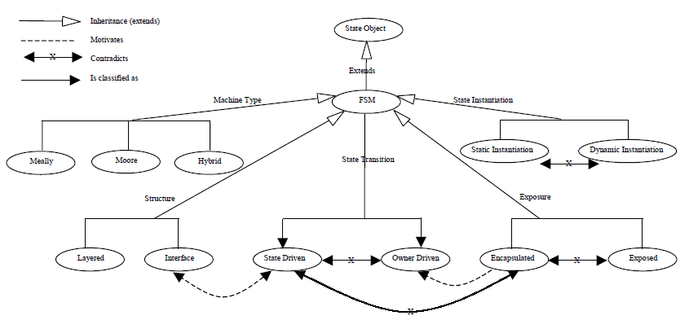
Finite State Machine Patterns
Sherif M. Yacoub and Hany H. Ammar. Finite State Machine Patterns. 1998.

Slide 10
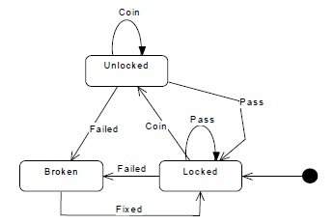
Basic Finite State Machine Pattern
Your application contains an object whose behavior depends on its state. The object's state changes according to events in the. The state transitions are determined from the object specification. How can you implement the object behavior in your design?
Use the state object pattern and add state transitions methods in response to state transition events.
FSM pattern = State Object Pattern + State Transition Mechanism
The state transition diagram (statechart) of a coin machine:

Slide 11
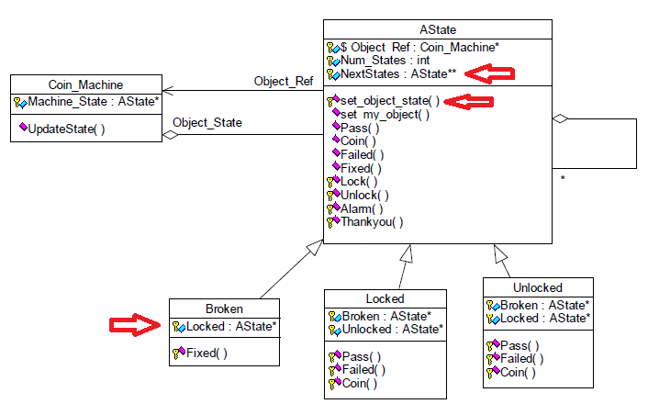
State-Driven Transition FSM Pattern
The state driven transition added the burden to the concrete state classes which requires more instantiation and declaration efforts to ensure that each concrete state class points correctly to the next states.
The state driven transition introduced dependencies between states.

Slide 12
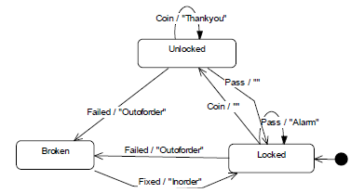
Meally FSM Pattern
How do you activate the FSM outputs if they should be produced at specific events while the object is in a particular state?
Make the concrete event method of each state initiate the required (output) action in response to the event.

Slide 13
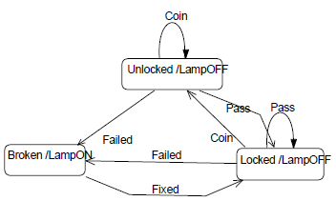
Moore FSM Pattern
How do you activate the FSM outputs if they are produced only at the state entry, and each state has a specific set of outputs?
Implement an output method in each state that calls the required actions. Make the state transition mechanism call the output method of the next upcoming state.

Slide 14
Encapsulated FSM pattern
Your FSM should follow a sequence of state changes that should not be changed by other application entities. How can you ensure no state changes are enforced to your object?
Encapsulate the current state inside the object itself and keep the state reference as a private attribute. Only the object itself can change its state by handling the events causing the state change but still delegate the behavior to the current state.

Slide 15
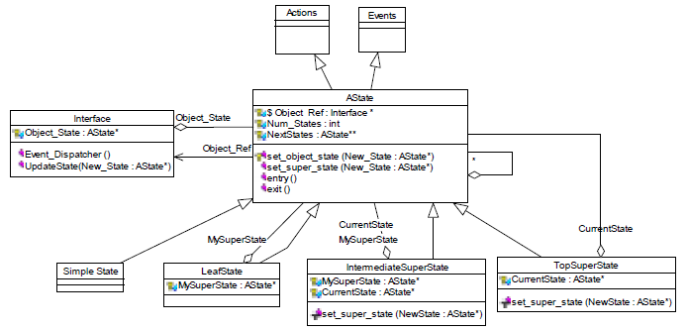
Hierarchical Statechart
Sherif M. Yacoub and Hany H. Ammar. A Pattern Language of Statecharts. 1998.
How do you implement the states hierarchy in your design?
State-Driven Transition FSM Pattern + Composite pattern.

Slide 16
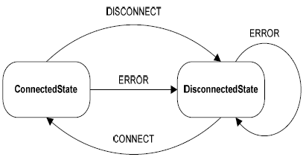
State Machine Design Pattern
Anatoly Shalyto et al.. State Machine Design Pattern. 2006.
Defining the transition logic in concrete states introduces dependencies between subclasses, which is an undesired coupling.
Separate classes which implement transition logic (Context) and state classes. Use events which are basically objects that state objects pass to Context to achieve an interaction between Context and state classes.
State Chart for class Connection:

Slide 17
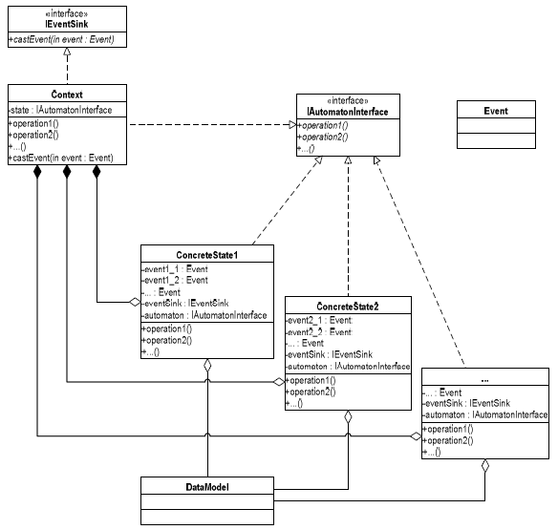
State Machine Design Pattern (cont.)

Slide 18
State vs. State Machine
In State pattern next state is explicitly pointed out by the current state.
In State Machine pattern it is done by notifying the Context with an event. After that it’s a Context’s responsibility to react and possibly change the state.

Slide 19
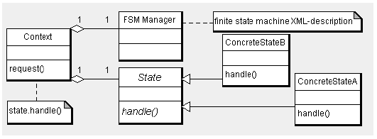
Finite State Machine Framework
http://unimod.sourceforge.net
Finite State Machine Framework is software that implements FSM and generates code from statecharts.
The transition logic is described in an XML file, and it is interpreted by a generic and reusable class named FSM Manager. The FSM Manager decouples transition logic from the State Pattern.

Slide 20
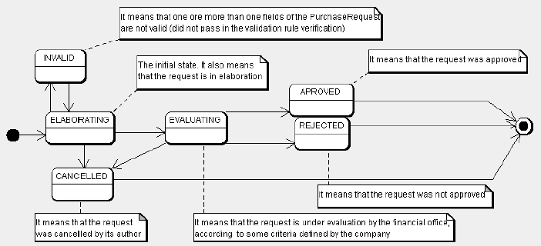
Persistent State Pattern
Andre V. Saude et al.. Persistent State Pattern. 2010.
A persistent object is an OO representation of a database entity.
UML statechart for the PurchaseRequest entity:

Slide 21
Persistent State Pattern (cont.)
Problem:
An entity is a FSM. The FSM may launch actions in cascade, and make many changes in the database. The FSM must be managed in a way to allow rollbacks in database transaction if any problem occurs in any level of the cascade.
Solution:
Integrate an FSM Pattern in a framework with managed transactions.

Slide 22
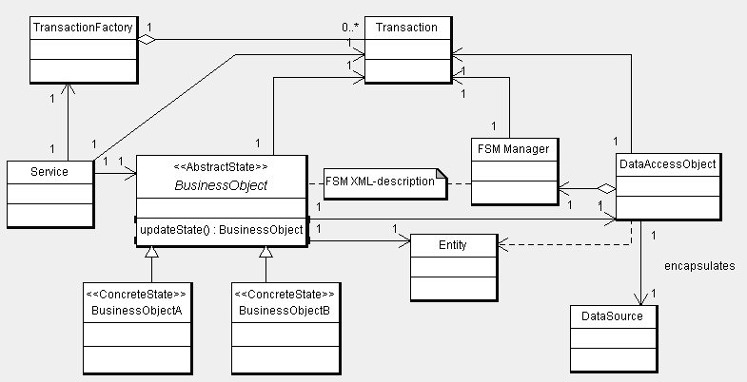
Persistent State Pattern (cont.)
Structure:

Slide 23
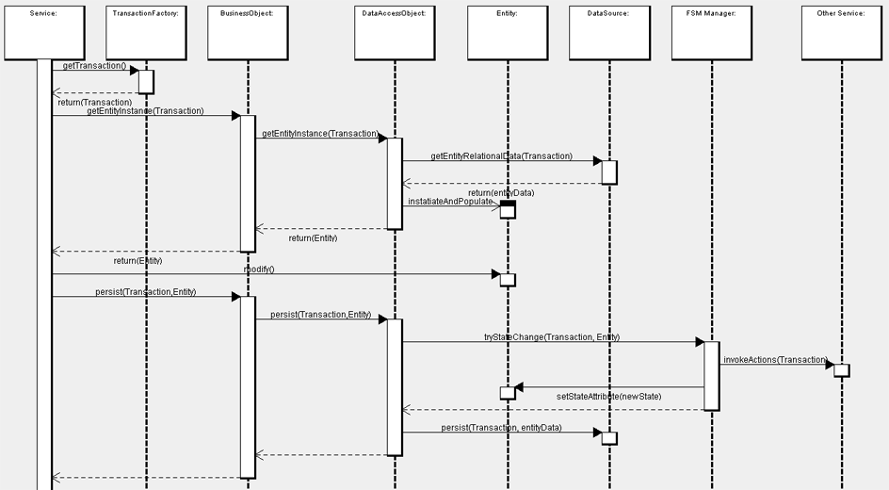
Persistent State Pattern (cont.)

Slide 24
Transaction
Problem:
When the persistence of entity (composition or hierarchy entity) is not an atomic operation. How can we ensure that everything is rolled back to previous state.
Example 1: a User Object has its Profile Object and Company Object. When User’s information is saved its Profile and Company will be saved first. If the action of saving User’s information is failed, its Profile and Company should be reverted to previous states.
Example 2: An Order object has its Payment and Order Item objects. When Order object is persisted, the system should process its Payment using 3rd party payment gateway (PayPal), then save Order information, then save its Order Items. If the action on the last Order Item is failed, the states of Payment and Order and other Order Items should be reverted.
Use Transaction

Slide 25
References
Paul Dyson and Bruce Anderson. State Patterns. 1996.
Jim Odrowski and Paul Sogaard. Pattern Integration - Variations of State. 1996.
Sherif M. Yacoub and Hany H. Ammar. Finite State Machine Patterns. 1998.
Sherif M. Yacoub and Hany H. Ammar. A Pattern Language of Statecharts. 1998.
Anatoly Shalyto et al.. State Machine Design Pattern. 2006.
Andre V. Saude et al.. Persistent State Pattern. 2010.
Eric Gamma, Richard Helm, Ralph Johnson, and John Vlissides. Design Patterns: Elements of Reusable Object-Oriented Software. 1995.

